Slide 1
APP Fraud and data analytics
Presented by Micah Holmquist

Slide 2
-Nigerian Prince Emails? -A Call Explaining that you Need to Reset your Password? -Texts Saying you Need to Pay a Bill Right Away?
These are all examples of Authorized Push Payment (APP) Fraud

Slide 3
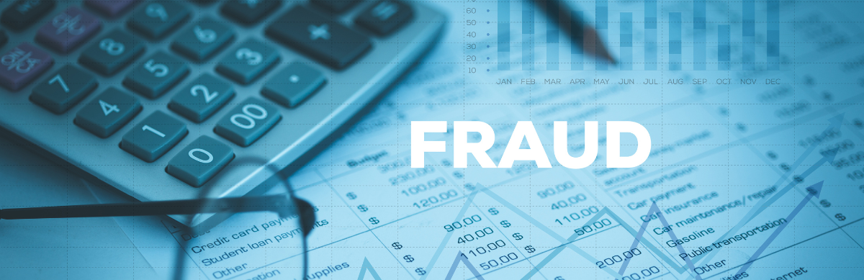
Outline
Problem of APP Fraud
Dataset and Methods
What did we find out?
How can financial institutions use these findings?
Limitations of the findings

Slide 4

Problem of financial fraud (specifically APP Fraud)
Financial Fraud
-Estimated to have been a $500 billion problem in 2023, and only growing
APP Fraud
-Estimated to have been a $8.3 Billion problem in the U.S. alone in 2024
-Projected to rise to nearly $15 billion in the U.S. by 2028
A Problem for Financial Institutions
-Traditionally viewed as the fault of the scammer and victim
-Increasingly seen as also a responsibility of financial Institutions
-Reduces faith in financial institutions

Slide 5

Why APP Fraud is a particular problem for financial institutions?
Detection
-Many of the traditional methods of detecting a suspicious transactions do not work
Anything that Delays Transactions is Disliked by Transactors
-Online Shopping
-Brick and Mortar Shopping
-Social Transfers
People Want to Make and Receive Payments FAST!

Slide 6
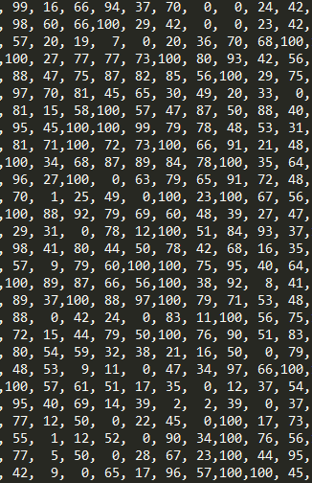

Dataset
Used synthetic dataset with 1 million transactions from Kaggle
Randomly picked 40,000 transactions
Split the 40,000 transactions into training (60%), validation (20%), and testing (20%)
Maintained a 3-to-1 split of non-suspicious to suspicious transactions in each subset

Slide 7
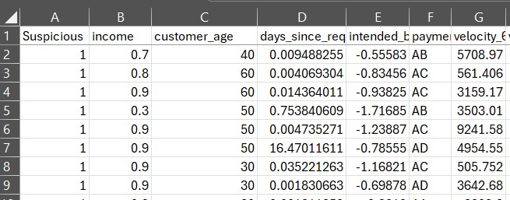
VARIABLES
Seventeen variables were used.
One dependent variable: Suspicious transaction (or not)
Sixteen independent variables were used make a determination on whether a transaction was suspicious or not.
-Some independent variables were specifically related to the transaction, such as the length of a session where the transaction was requested and the amount of activity related to the transaction
-Others related to the customer such as their housing status, income, and age
The process used the independent variables (input) to decide whether a transaction was suspicious or not (output)

Slide 8
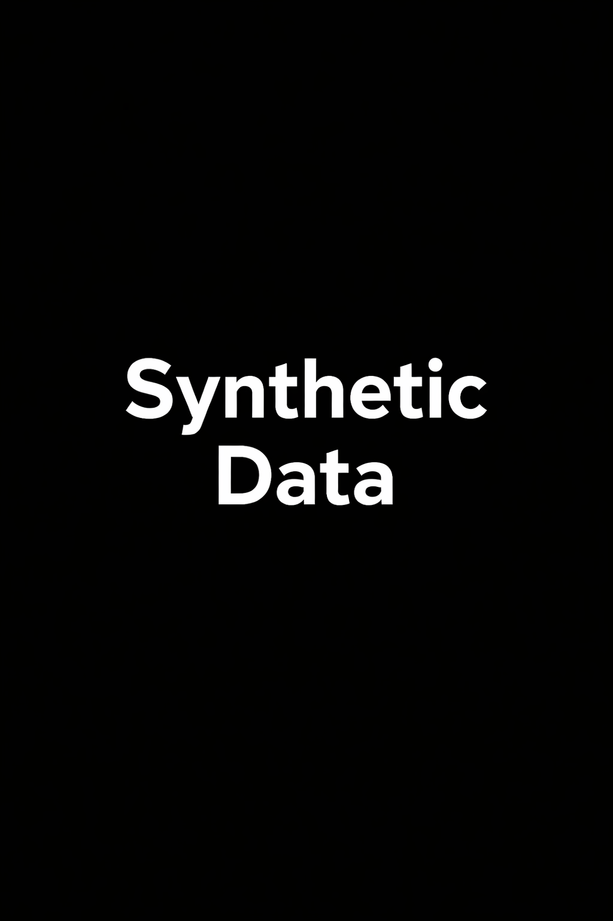
Synthetic Data?
Synthetic data is artificially generated information that mimics the properties and structure of real-world data but does not correspond to actual events or individuals.
Why Use Synthetic Data for Financial Fraud Detection Exercises?
-Privacy Protection: Synthetic data avoids exposing sensitive customer information or confidential transactions.
-Data Availability: It enables the creation of large, diverse datasets, even when real fraudulent transactions are rare or hard to access.
-Controlled Testing: By designing specific fraud scenarios, synthetic data allows for targeted evaluation and robust training of fraud detection systems.
Using synthetic data allows safe, flexible, and effective development of fraud detection models without compromising real customers' privacy.
Any model used in the real world should be based on real-world data.

Slide 9
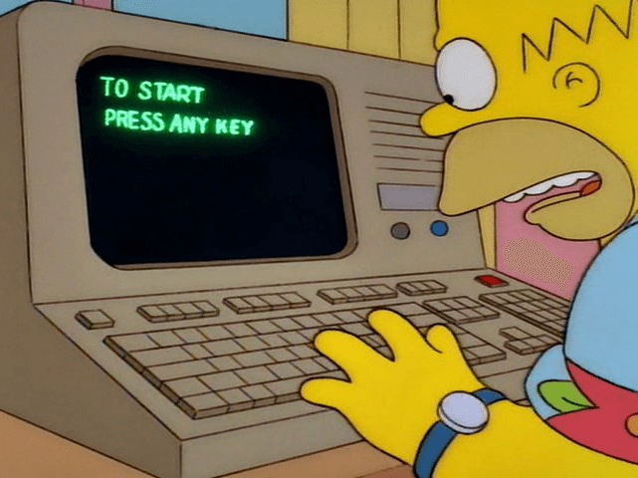
Methods
1) Decision Tree
2) Random Forest
3) K-Nearest Neighbors (KNN)

Slide 10
Results
Method | Accuracy | Area Under the Curve
Decision Tree | 0.7622 | 0.6081
Random Forest | 0.8090 | 0.8054
KNN | 0.7975 | 0.7986
A higher score is better score in both metrics.
Random Forest performs the best and at a level better than just labeling everything non-suspicious

Slide 11
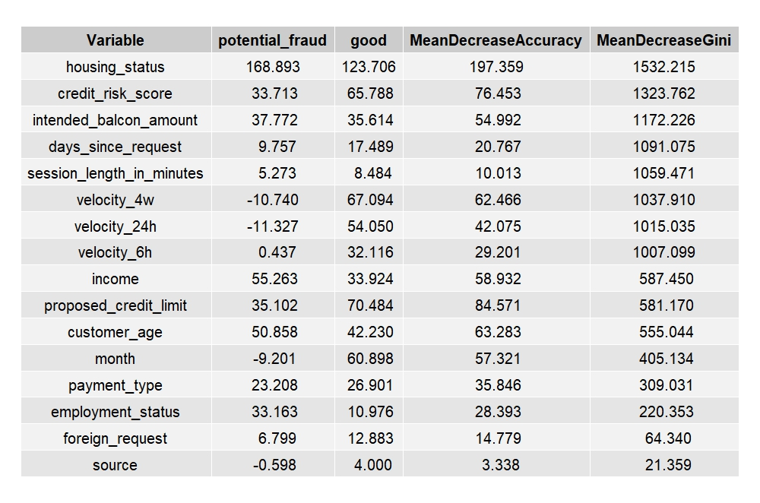
The Elements that Make up the Random Forest Model
The higher the score, the greater the impact of removing a variable on the model
Variables that have the greatest impact include both those relating to:
-Customer’s identity: housing status, credit score and limits, income
-The Transaction itself: frequency of activity related to the transaction
It should be stressed that correlation and not causation has been established

Slide 12

So how can this be used by financial institutions?
It shows that these techniques can produce an improved model
Resources can be allocated to higher risk transactions
Customers at higher risk can be targeted for education on APP fraud, including in real time

Slide 13

Limitations
Results may differ if real world data is used
APP fraud techniques are fast evolving, so any model would have to be regularly updated
Certain factors can be related to social phenomenon and thus should be handled with care
How much in the way of slowed transactions can be justified is not something data analysis can answer

Slide 14
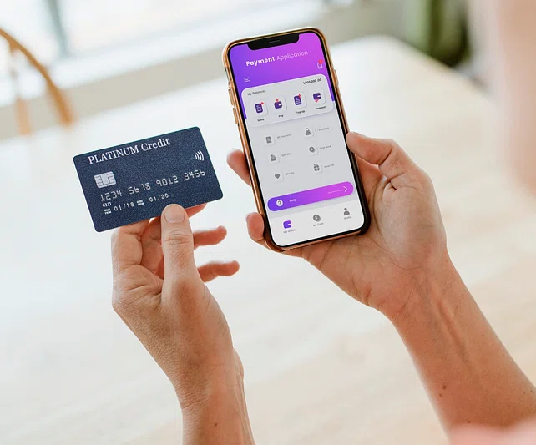
But the possibilities are great
Financial Institutions have an obligation to combat APP Fraud
Data analytics are a critical part of any attempt to identify transactions that are more likely to be APP fraud
Leadership at institutions ultimately are the ones who will determine how the results of data analytics are used
Any questions?

